Slide 1



CEPS Engineering Organization
Welding
University of New Hampshire
Students for the Exploration and Development of Space

Slide 2
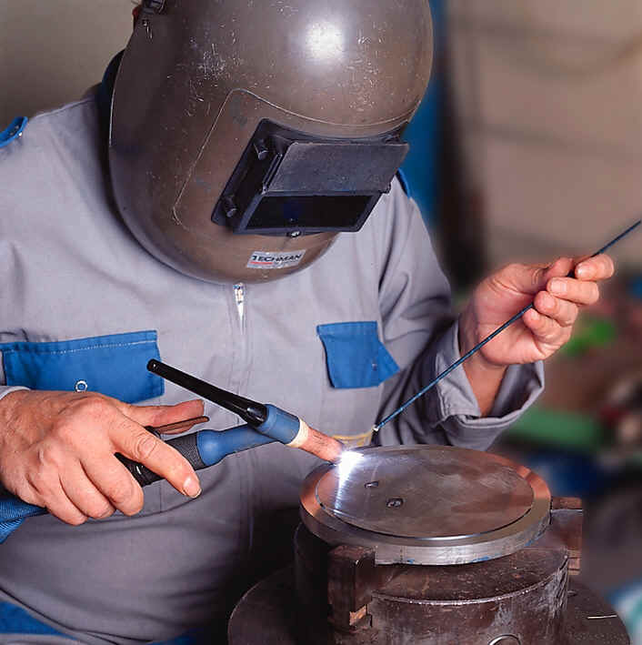
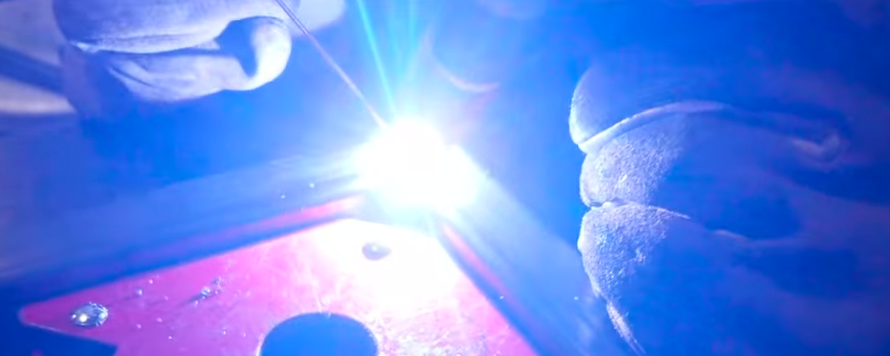
Tungsten inert gas welding (tig)
University of New Hampshire
Students for the Exploration and Development of Space

Slide 3
Background
What is TIG?
Tungsten Inert Gas
Also referred to as GTAW
Gas Shielded Tungsten Welding
In TIG welding, a tungsten electrode heats the metal you are welding and gas (most typically Argon) protects the weld from airborne contaminants
University of New Hampshire
Students for the Exploration and Development of Space

Slide 4
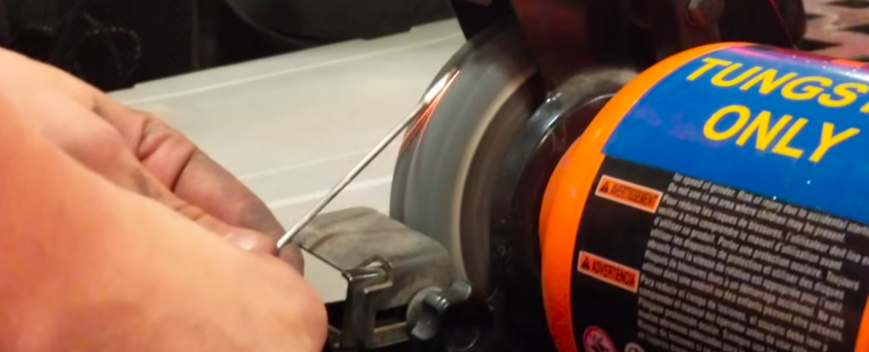
Background
TIG welding uses a non-consumable tungsten
Filler metal, when required, is added by hand
Shielding gas protects the weld and tungsten
University of New Hampshire
Students for the Exploration and Development of Space

Slide 5
Advantages
Welds more metals and metal alloys than any other process
High quality and precision
Aesthetic weld beads
No sparks or spatter
No flux or slag
No smoke or fumes
University of New Hampshire
Students for the Exploration and Development of Space

Slide 6
Disadvantages
Lower filler metal deposition rates
Good hand-eye coordination a required skill
Brighter UV rays than other processes
Slower travel speeds than other processes
Equipment costs tend to be higher than other processes
University of New Hampshire
Students for the Exploration and Development of Space

Slide 7
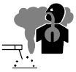
Safety
Electric shock can kill.
Always wear dry insulating gloves
Insulate yourself from work and ground
Do not touch live electrical parts
Keep all panels and covers securely in place
Fumes and gases can be hazardous to your health.
Keep your head out of the fumes
Ventilate area, or use breathing device
University of New Hampshire
Students for the Exploration and Development of Space

Slide 8
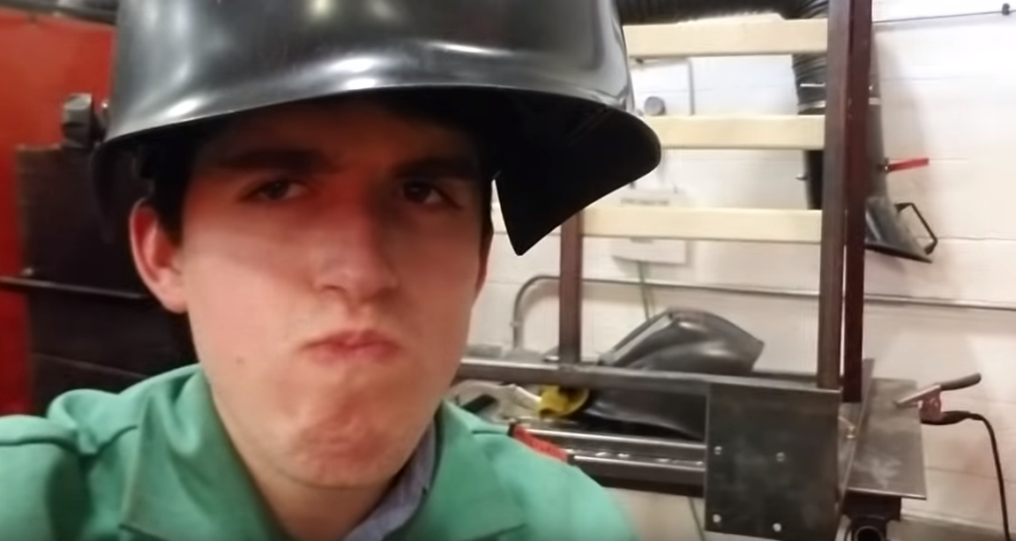
Safety
Welding can cause fire or explosion.
Do not weld near flammable material
Watch for fire; keep extinguisher nearby
Do not locate unit over combustible surfaces
Do not weld on closed containers
Arc rays can burn eyes and skin; Noise can damage hearing.
Wear welding helmet with correct shade of filter
Wear correct eye, ear, and body protection
University of New Hampshire
Students for the Exploration and Development of Space

Slide 9

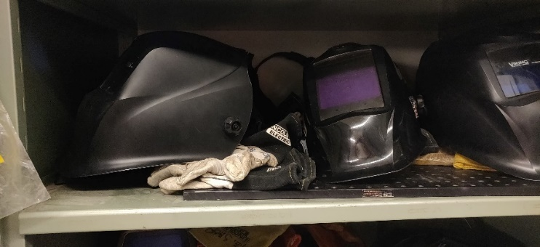
Safety
Hot parts can cause injury.
Allow cooling period before touching welded metal
Wear protective gloves and clothing
Magnetic fields from high currents can affect pacemaker operation.
Flying metal can injure eyes.
Welding, chipping, wire brushing, and grinding cause sparks and flying metal; wear approved safety glasses with side shields
University of New Hampshire
Students for the Exploration and Development of Space

Slide 10
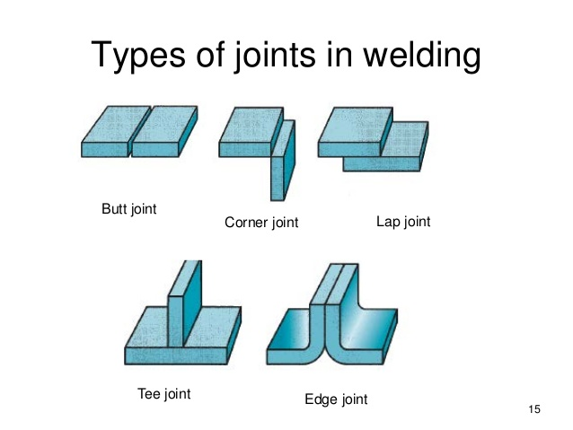
Types of Weld Joints
Each one include different overall techniques for laying beautiful beads
All the advice you would need can be found with a simple google search
University of New Hampshire
Students for the Exploration and Development of Space

Slide 11
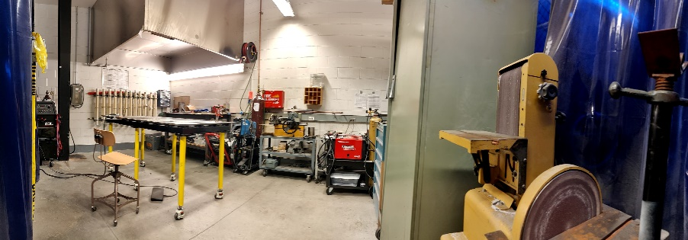
Our Shop - Overview
University of New Hampshire
Students for the Exploration and Development of Space

Slide 12
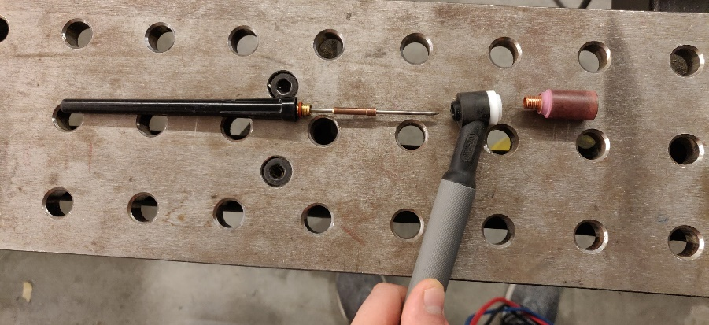
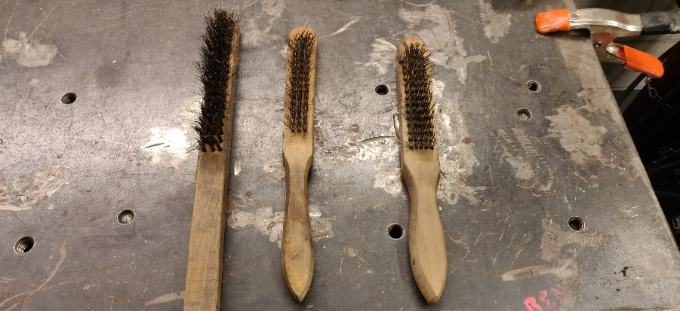
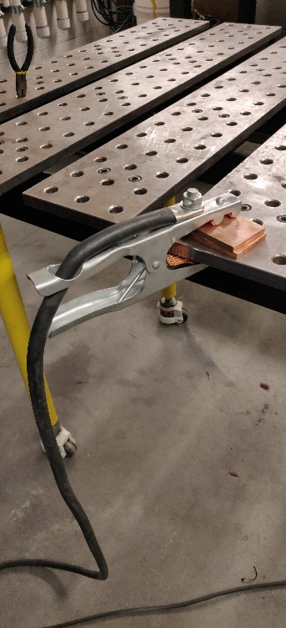
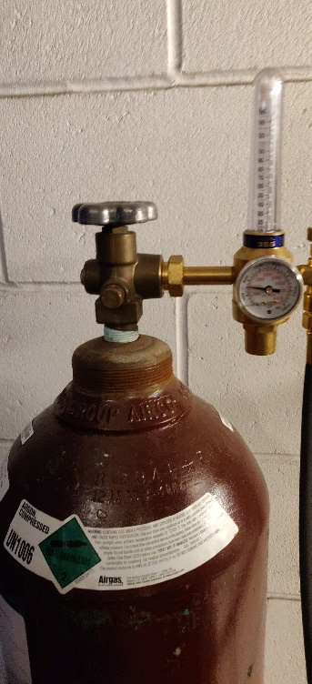
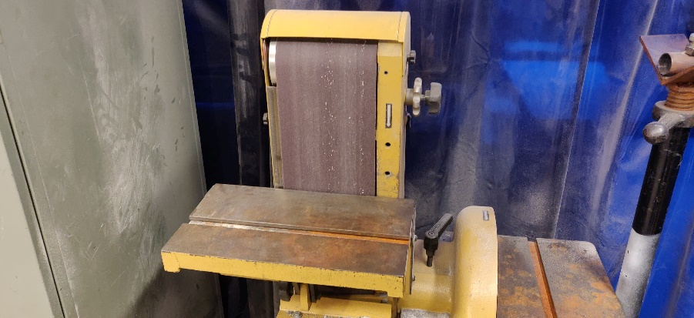
Our Shop - Preparation
The Tig Torch
There is no such thing as TOO clean!
Turn on Argon Flow
Starts when Tig Welding starts
Ground the Worktable
The Tig Torch
University of New Hampshire
Students for the Exploration and Development of Space

Slide 13
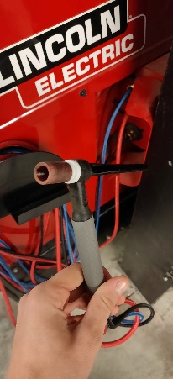
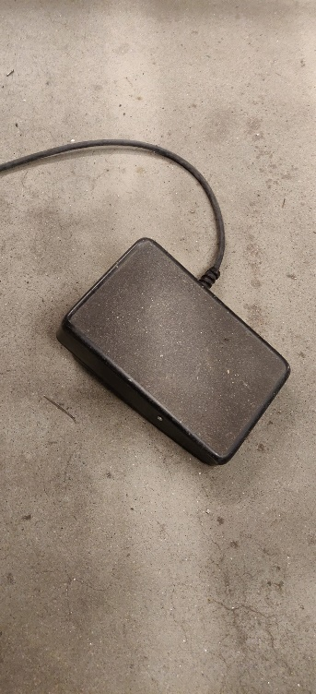
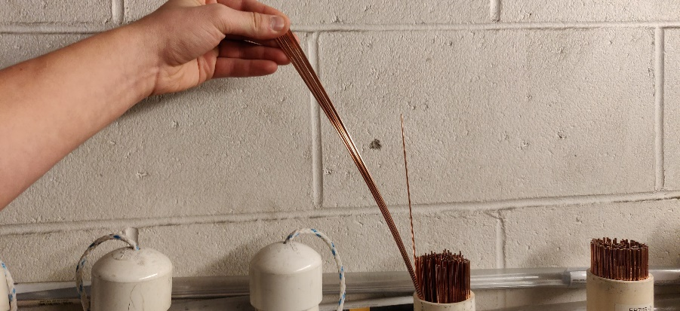
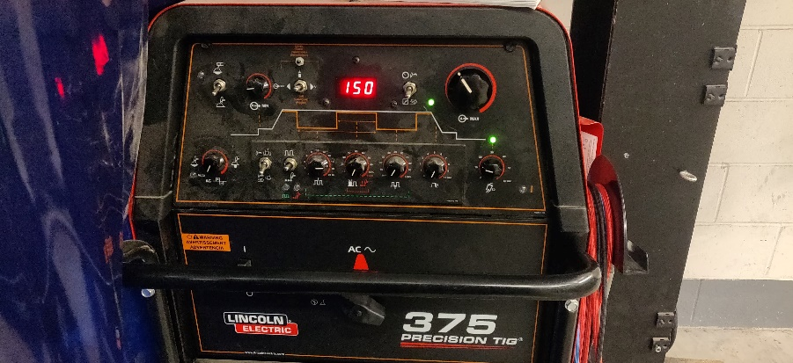
Our Shop – Final Checks
Select the right filler (material, thickness)
Select the right settings on the machine
Amperage
AC/DC
etc
Make sure torch is good to go
Get pedal in a comfortable spot
University of New Hampshire
Students for the Exploration and Development of Space

Slide 14
Our Shop – ENSURE PPE
Jacket
Helmet (power on)
Gloves
University of New Hampshire
Students for the Exploration and Development of Space

Slide 15
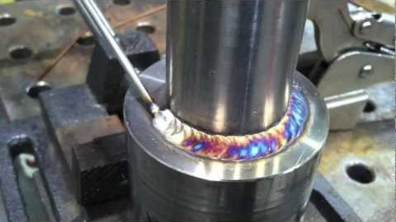
Example of Welding
University of New Hampshire
Students for the Exploration and Development of Space

Slide 16
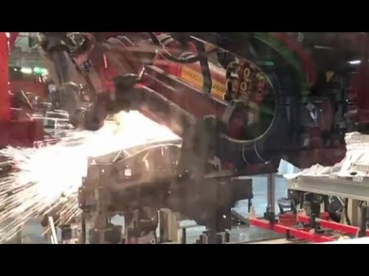
The Future of Welding
Humans are too imperfect
Robots can ensure the same thing happens every time…
Cough…starship…cough
University of New Hampshire
Students for the Exploration and Development of Space

Slide 17
Welding Parameters
Aluminum weld parameters
University of New Hampshire
Students for the Exploration and Development of Space

Slide 18
Welding Parameters
Stainless steel weld parameters
University of New Hampshire
Students for the Exploration and Development of Space

Slide 19
Welding Parameters
Mild steel weld parameters
University of New Hampshire
Students for the Exploration and Development of Space

Slide 20
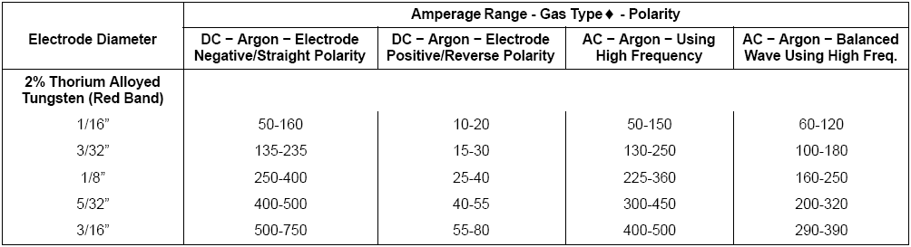
Electrode Selection
University of New Hampshire
Students for the Exploration and Development of Space

Slide 21
Apps
Pocket Welder Helper
Miller Welding
Helps you select the right settings and equipment for a particular weld job
University of New Hampshire
Students for the Exploration and Development of Space

